Slide 1
Decision tree homework
CP600 – fall 2020

Slide 2
Objectives step by step
Decision tree basic
Some online notes
Homework instruction
Some errors in the instruction
Major implementations
Questions to discuss

Slide 3
An example of a tree
https://towardsdatascience.com/machine-learning-basics-descision-tree-from-scratch-part-i-4251bfa1b45c

Slide 4
https://towardsdatascience.com/machine-learning-basics-descision-tree-from-scratch-part-i-4251bfa1b45c

Slide 5
Basic terminologies
Root Node (Top Decision Node): It represents the entire population or sample and this further gets divided into two or more homogeneous sets.
Splitting: It is a process of dividing a node into two or more sub-nodes.
Decision Node: When a sub-node splits into further sub-nodes, then it is called a decision node.
Leaf/ Terminal Node: Nodes with no children (no further split) is called Leaf or Terminal node.
Pruning: When we reduce the size of decision trees by removing nodes (opposite of Splitting), the process is called pruning.
Branch / Sub-Tree: A sub section of the decision tree is called branch or sub-tree.
Parent and Child Node: A node, which is divided into sub-nodes is called a parent node of sub-nodes whereas sub-nodes are the child of a parent node.
https://towardsdatascience.com/machine-learning-basics-descision-tree-from-scratch-part-i-4251bfa1b45c

Slide 6
How does a decision tree work
Top-Down approach: a decision tree classifies the examples by sorting them down the tree from the root to some leaf node, with the leaf node providing the classification to the example
Each node in the tree acts as a test case for some attribute, and each edge descending from that node corresponds to one of the possible answers to the test case.
This process is recursive and is repeated for every subtree rooted at the new nodes.
https://towardsdatascience.com/machine-learning-basics-descision-tree-from-scratch-part-i-4251bfa1b45c

Slide 7
How does a decision tree work
Select the best attribute using Attribute Selection Measures(ASM) to split the records.
Make that attribute a decision node and breaks the dataset into smaller subsets.
Starts tree building by repeating this process recursively for each child until one of the condition will match:
All the tuples belong to the same attribute value.
There are no more remaining attributes.
There are no more instances.
https://towardsdatascience.com/machine-learning-basics-descision-tree-from-scratch-part-i-4251bfa1b45c

Slide 8
Attribute Selection Measures (ASM)
Entropy
Information gain
Gini Index
Gain ratio
Reduction in variance
Chi-Square
CHAID (Chi-squared Automatic Interaction Detector)

Slide 9
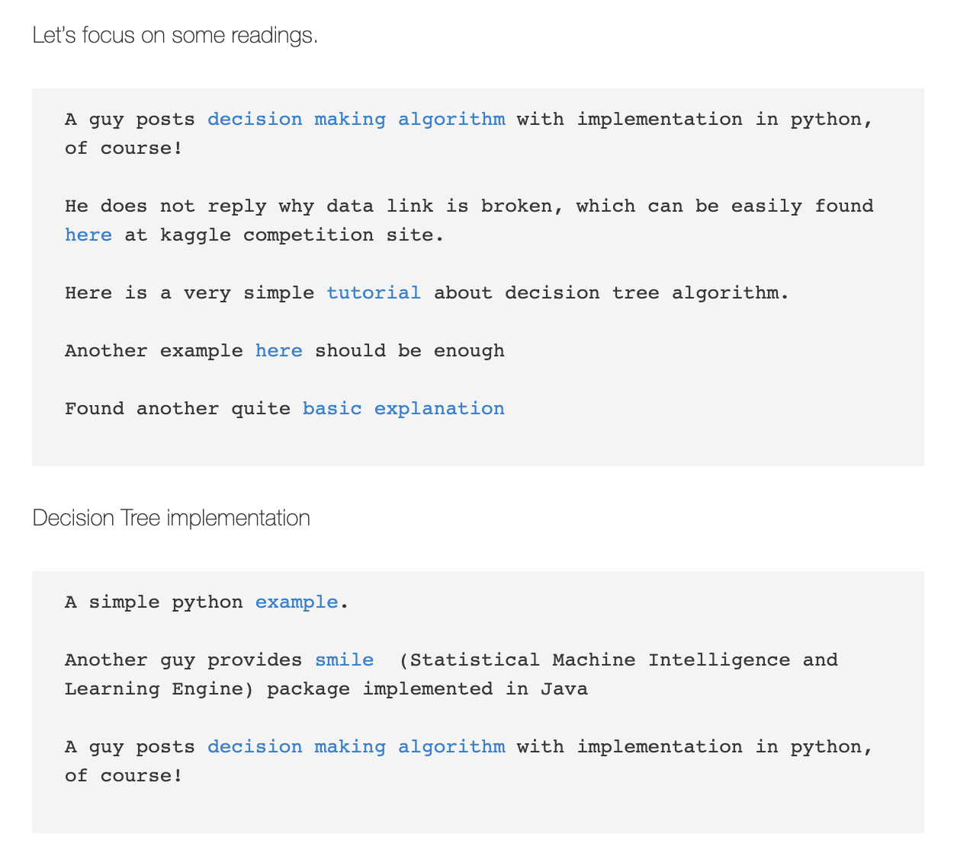
My note on machine learning
https://sites.duke.edu/workblog/2020/11/04/machine-learning-note/

Slide 10
A few very good learning portals
https://www.kdnuggets.com/2020/01/decision-tree-algorithm-explained.html
https://dataaspirant.com/how-decision-tree-algorithm-works/
https://www.geeksforgeeks.org/decision-tree-introduction-example/
https://towardsdatascience.com/machine-learning-basics-descision-tree-from-scratch-part-i-4251bfa1b45c
https://www.geeksforgeeks.org/decision-tree-implementation-python/

Slide 11
Our homework problem
11062020

Slide 12
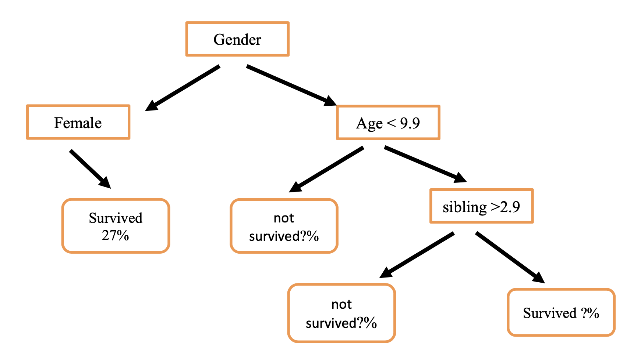
Proposed tree structure

Slide 13
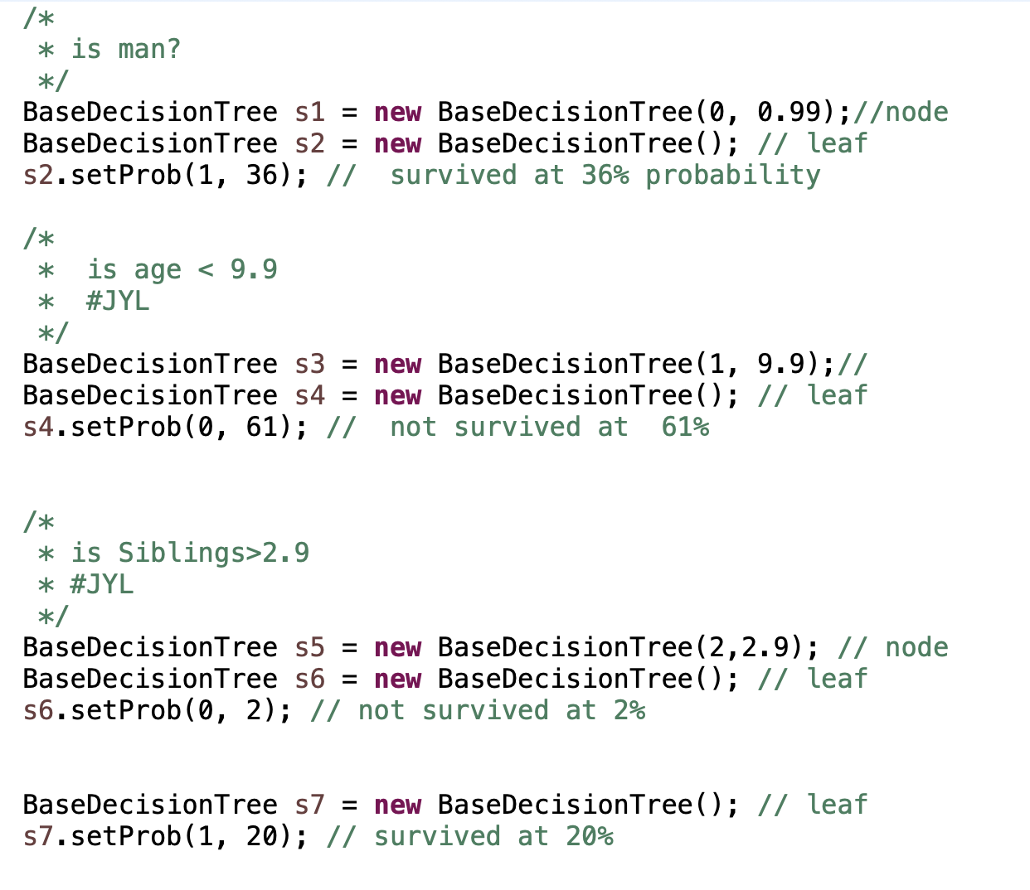
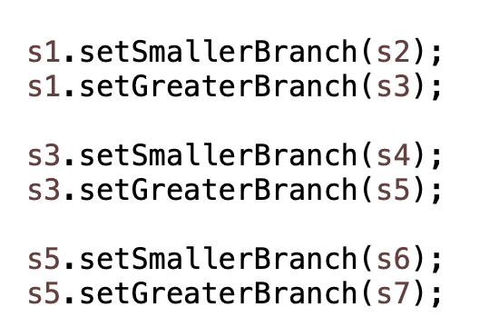
Left
Right
Left
Right
Left
Right

Slide 14
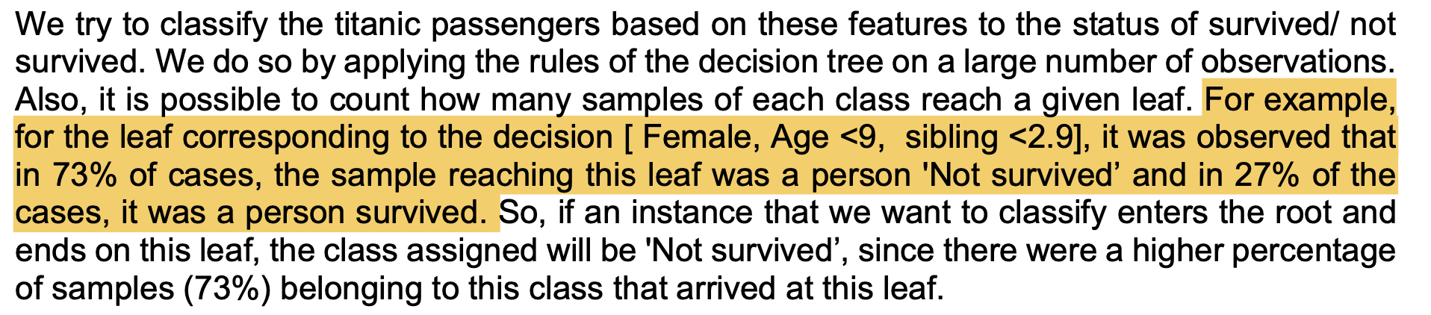
An example, but we are confused
For example, for the leaf corresponding to the decision [ Female, Age <9, sibling <2.9]
Could be “arbitrary” but not in this example?
It was observed that in “73% of cases”, the sample reaching this leaf was a person 'Not survived’ and in 27% of the cases, it was a person survived.

Slide 15
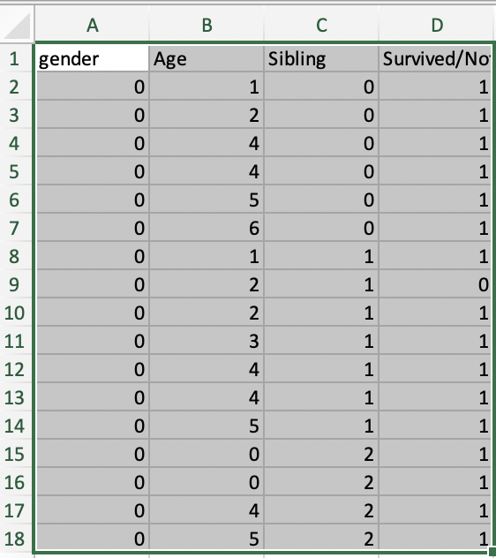
[ Female, Age <9, sibling <2.9]
Survival rate = 16/17 = 94.11%

Slide 16
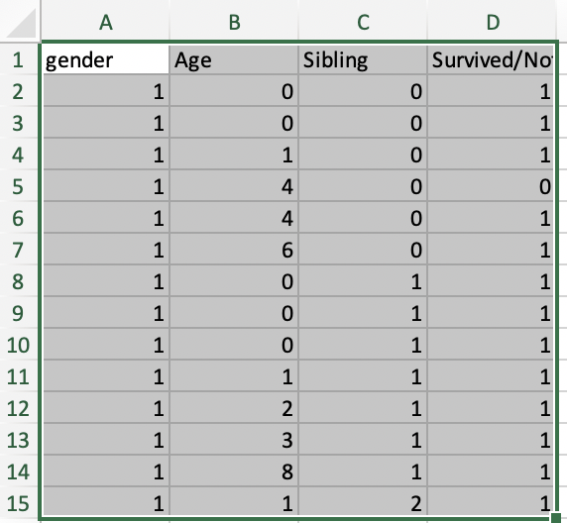
[ Male, Age <9, sibling <2.9]
Survival rate = 13/14 = 92.86%

Slide 17
[ Male, Age <9, sibling >2.9] (home work for Lucy)
Survival rate = ??

Slide 18
What we have in the homework
Prediction features
Gender
Age
Number of siblings
Prediction outcome
Survival (%)
Procedure
The entries of the decision vector and applies a threshold.
Depending on the result of the comparison, we branch left or right.
A feature vector enters the tree by the root.
It follows a series of comparisons leading to a leaf of the tree.

Slide 19
Main tasks in this homework
To fill in all the missing “probabilities”
A few java methods need to be implemented/completed
Predict the accuracy
Write out a report

Slide 20
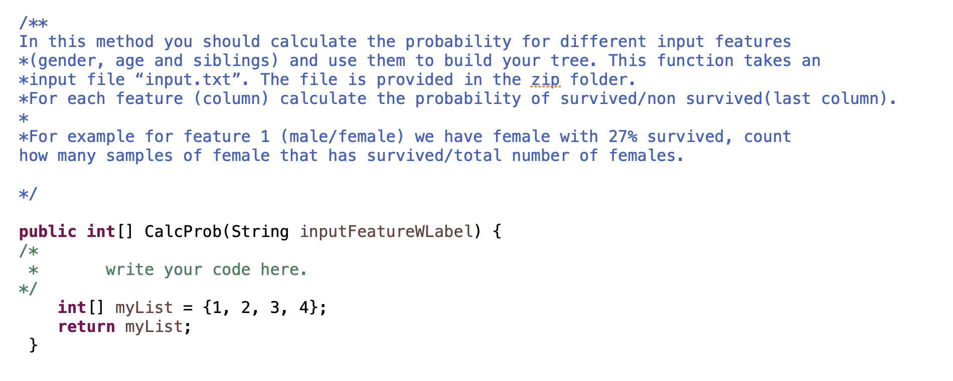
Major implementation (1)
Almost done

Slide 21
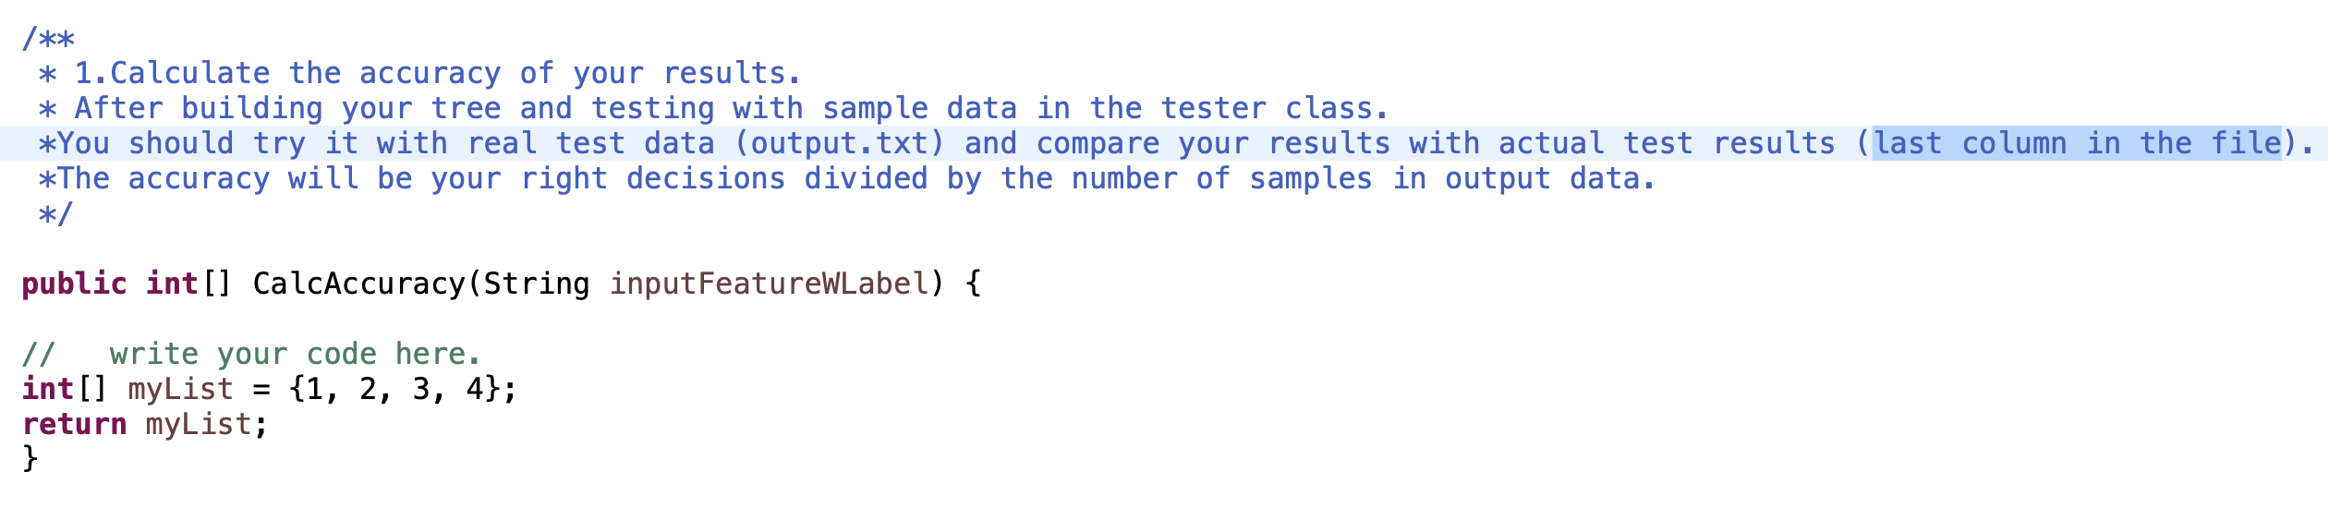
Major implementation (2)
Upcoming

Slide 22
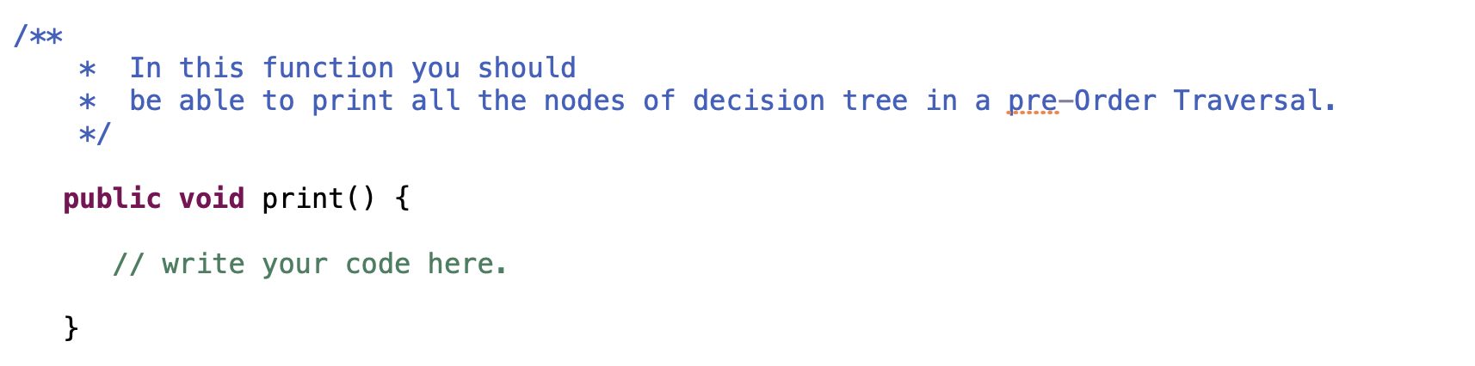
Major implementation (3)
Assigned

Slide 23
Other implementation

Slide 24
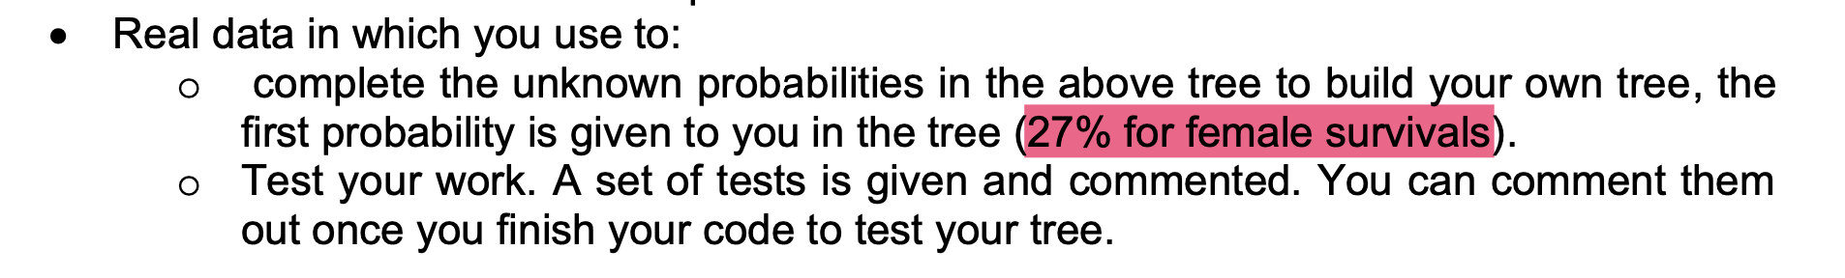
27% of female survivals – where does it come from?
There are 663 entries
Of which, there are 239 females
Then, out of 239 females, 180 survived, 180/239 = 75.31%
Therefore, it reports as 180/663 = 27.15%
I think it is WRONG!

Slide 25
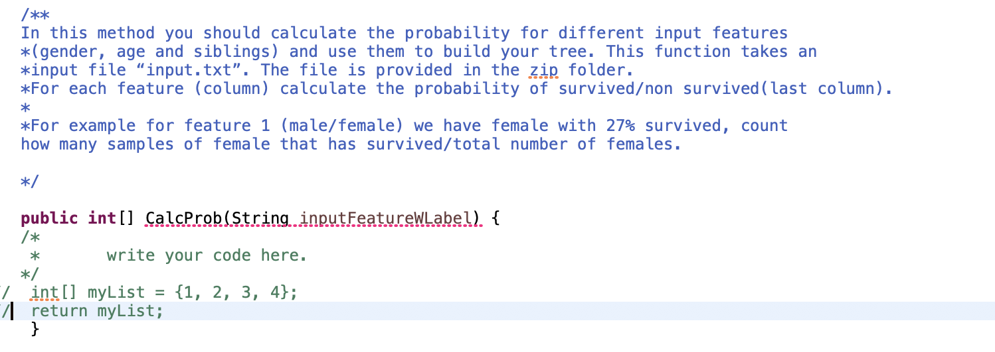
I think it is WRONG!

Slide 26

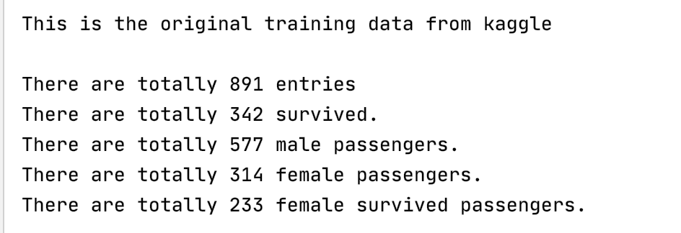
The professor’s response
Female survival rate is: 233/314 = 74.20%
https://www.kaggle.com/c/titanic/data

Slide 27
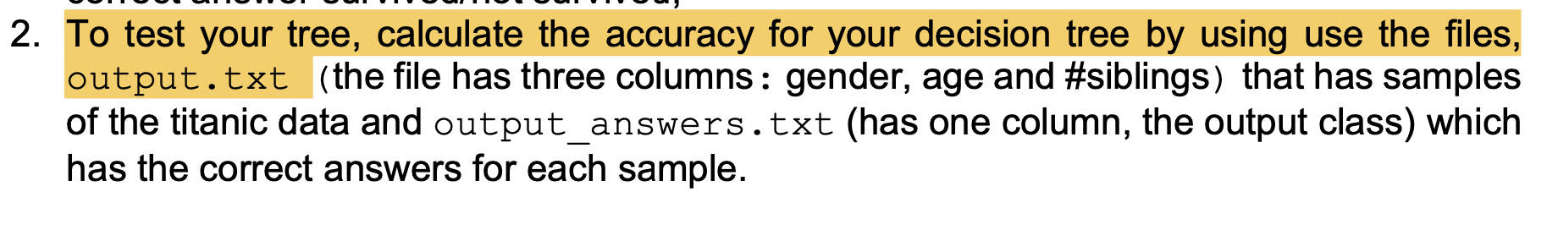
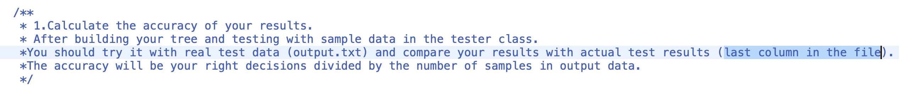
Inconsistency in the instructions

Slide 28
How do human language match the computer language
The entries of the decision vector and applies a threshold
Which method does this job?
Depending on the result of the comparison, we branch left or right
Which method does this job?
A feature vector enters the tree by the root
Which method does this job?
It follows a series of comparisons leading to a leaf of the tree
What is the end result?

Slide 29
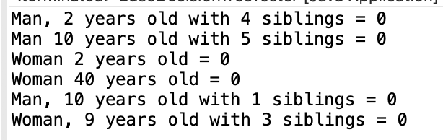
Question 1: why all the results are NOT survived?

Slide 30
Question 2: under the SAM (bonus)
With three features (gender, age, and siblings)
Calculate “the entropy” for each feature
Calculate “the information gain” for each feature

Slide 31
Questions that I need help with
Please email the professor or ask your friend if you do NOT have an answer for me

Slide 32
Q1: 27% of female survivals – where does it come from?
There are 663 entries
Of which, there are 239 females
Then, out of 239 females, 180 survived, 180/239 = 75.31%
Therefore, it reports as 180/663 = 27.15%

Slide 33
The professor’s response -- I can barely accept
Female survival rate is: 233/314 = 74.20%
https://www.kaggle.com/c/titanic/data

Slide 34
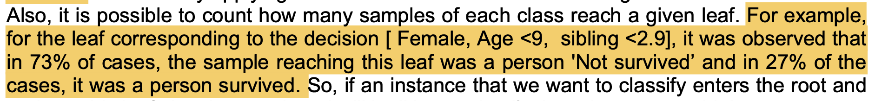

Q2:we will NEVER have this case?
Given the tree in the homework instruction, how can we get answer 1??

Slide 35
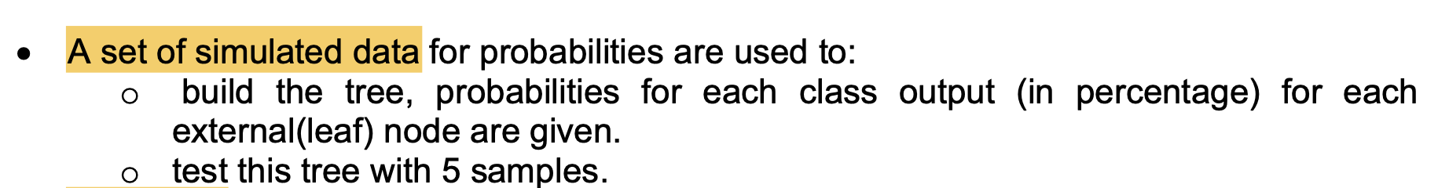
Q3, which/where is the simulated data?
Is it input.txt??

Slide 36
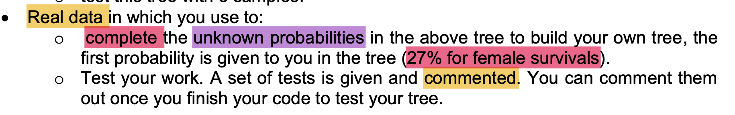
Q3, which/where is the real data?
It seems to be input.txt, but need to be sure

Slide 37
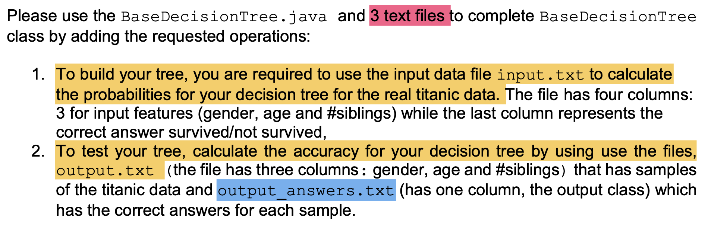
Q4, we ONLY have two .txt files
where it the third one?? Or, could it be a typo??

Slide 38
Q5, the instruction is NOT clear

Slide 39
Additional slides

Slide 40
Traversal order

Slide 41
The chee sheet
https://cgi.csc.liv.ac.uk/~frans/KDD/Software/DecisionTrees/decisionTree.html

